Slide 1
Evaluating ML Models for Modelling Piezo Dynamics
29.7.24
David Kleindiek

Slide 2
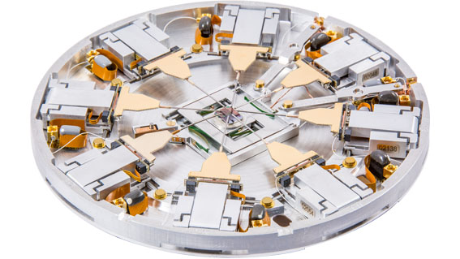
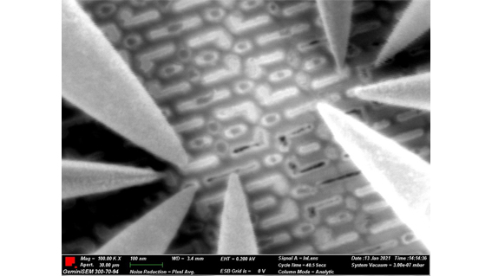
Introduction
Nanoprobing
Semiconductors Failure Analysis
Driven by piezo motors
Sub-nanometre accuracy

Slide 3
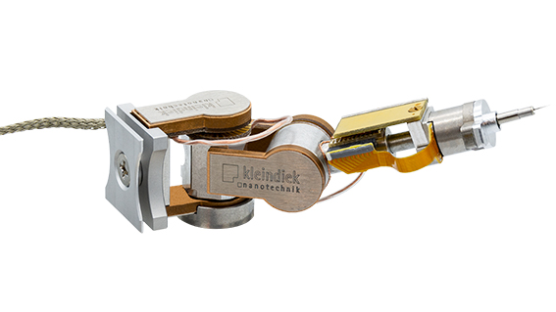
Devices
MM3E
Three axis
Input voltage: -80V to 80V
Max displacement: a, b=20µm, c=3µm
Encoder resolution: a, b=250nm c=20nm
C Axis used to capture data

Slide 4
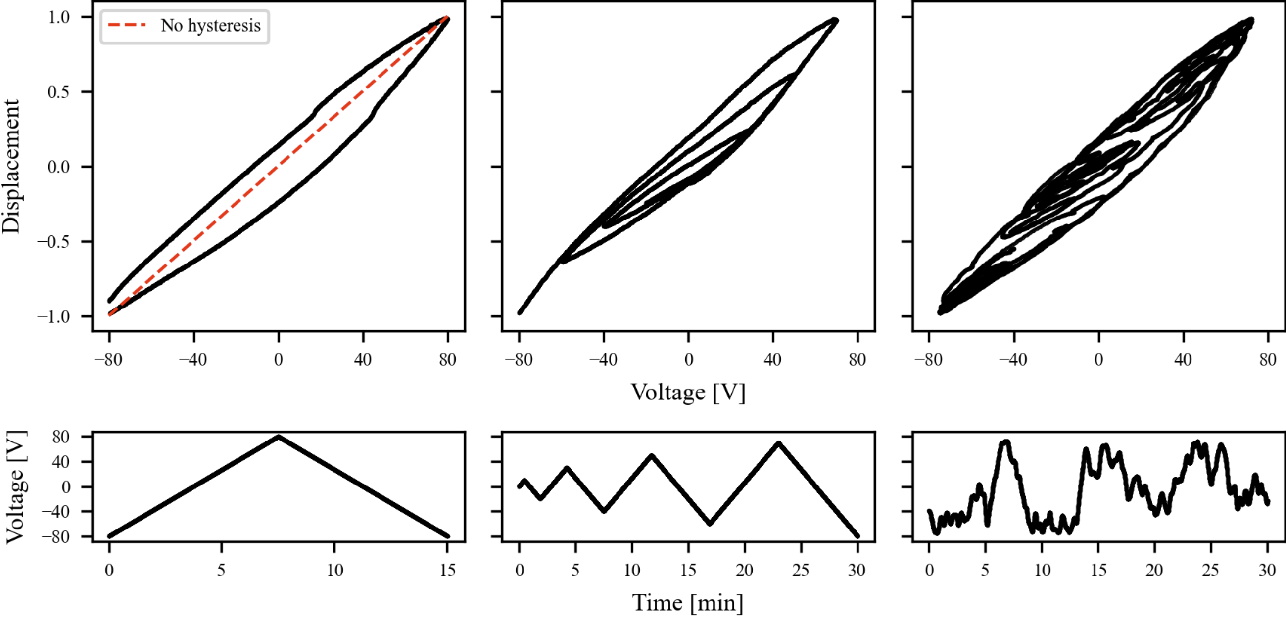
Challenges: Hysteresis
Non-linear relation between input voltage and displacement
Dependent on current and past applied voltages

Slide 5
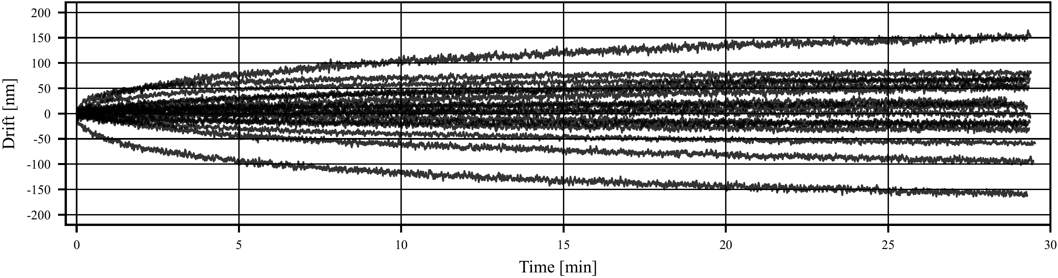
Challenges: Creep
Slow drift of displacement after voltage step
Up to 15% deviation from desired position
Time dependent on previous applied voltages

Slide 6
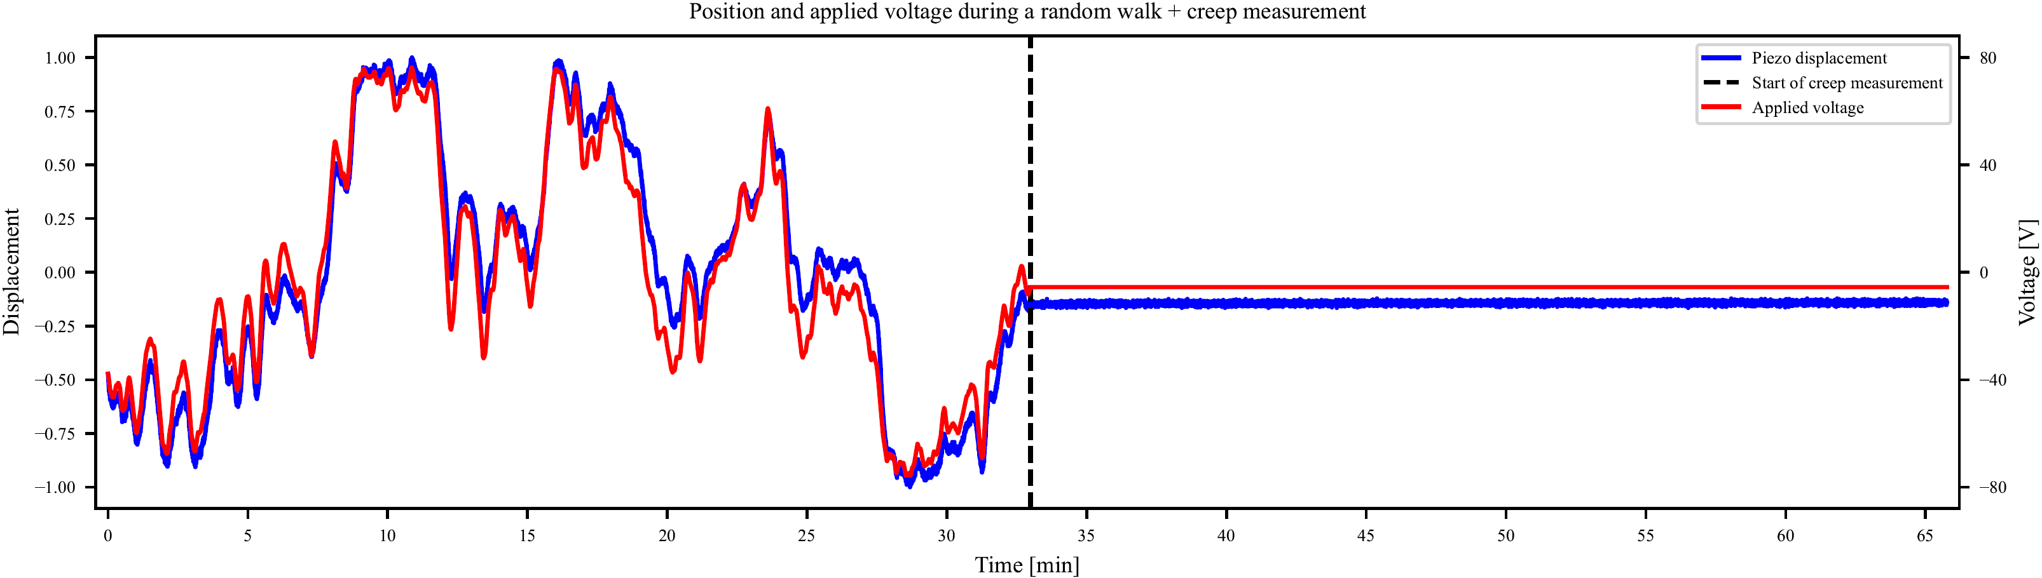
Data collection
Modified random walk
>32 hours of movement data
>7 hours of creep recording

Slide 7
Feature enginering
Dependency on past applied voltages
Step size
Rolling exponential sums
Lagged position
Voltage differentiating
Lasso regression for feature selection

Slide 8

Models
Linear Regression
Vanilla Neural Network
Long short-term memory
Kolmogorov-Arnold Networks
Hyperparameter Optimization Framework:
https://github.com/optuna/optuna

Slide 9
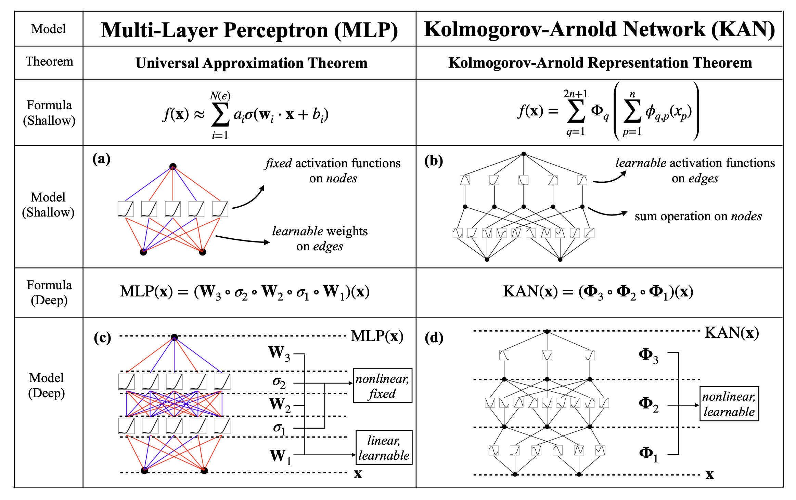
KAN: Kolmogorov-Arnold Networks
Faster scaling
Interpretability
https://github.com/KindXiaoming/pykan

Slide 10
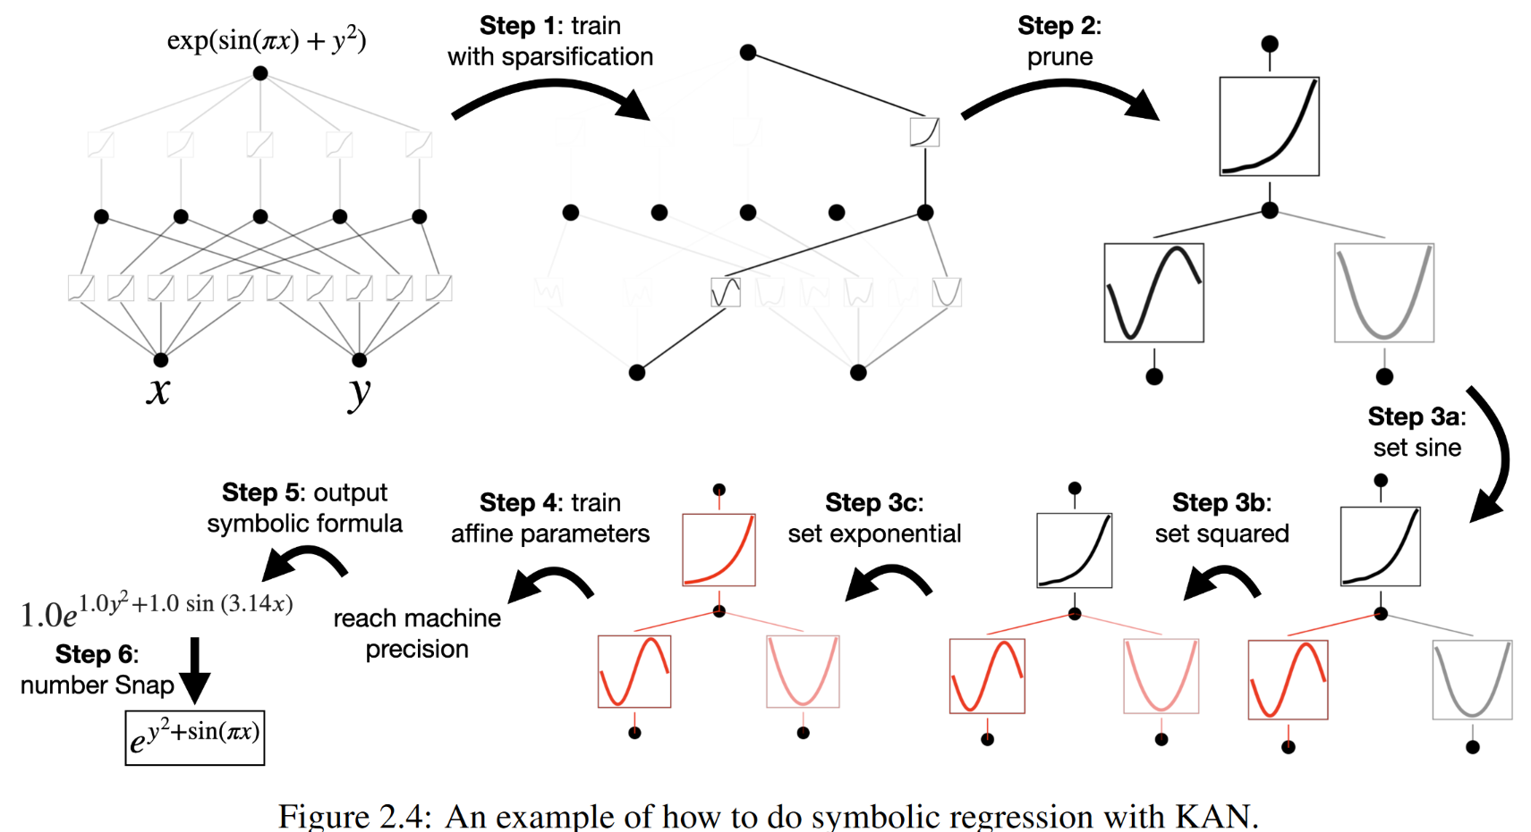
KAN: Training
https://arxiv.org/abs/2404.19756

Slide 11
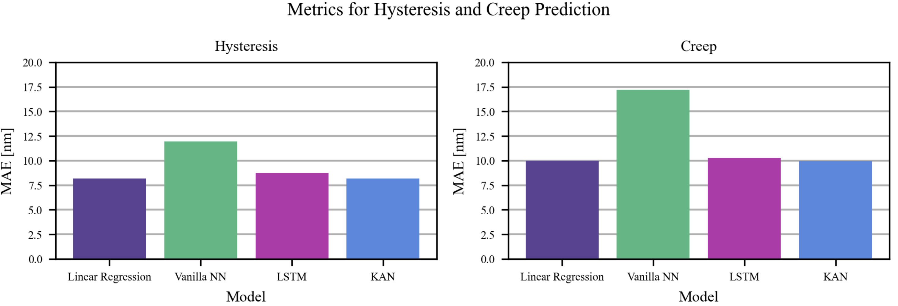
Metrics

Slide 12
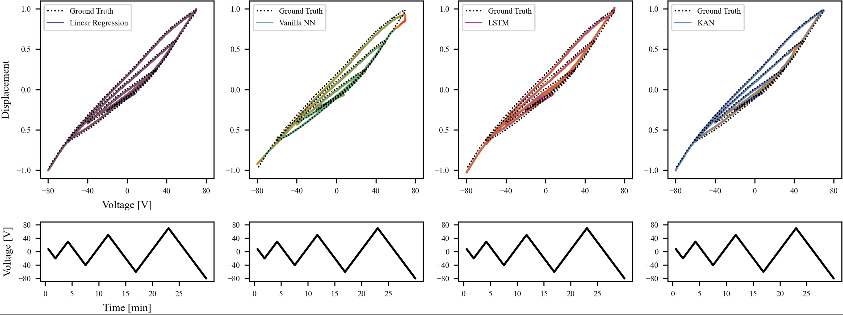
Evaluation: Hysteresis
Turning points pose a problem for neural network

Slide 13
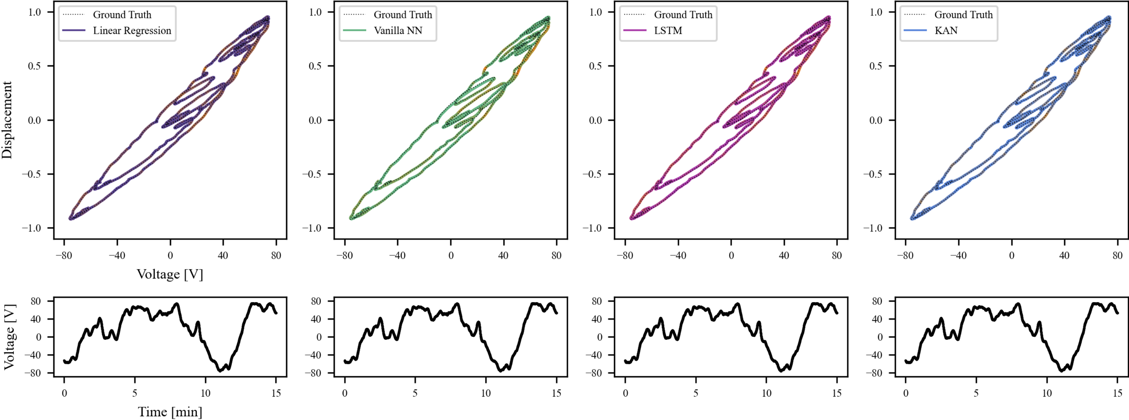
Evaluation: Hysteresis

Slide 14
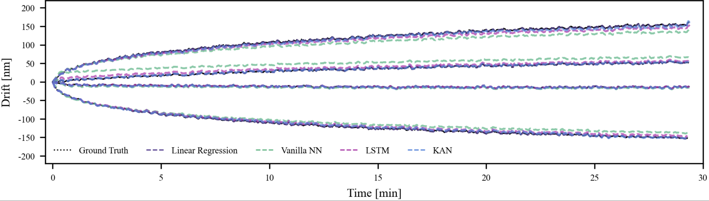
Evaluation: Creep
Vanilla NN and LSTM deficate slightly
KAN near perfect

Slide 15
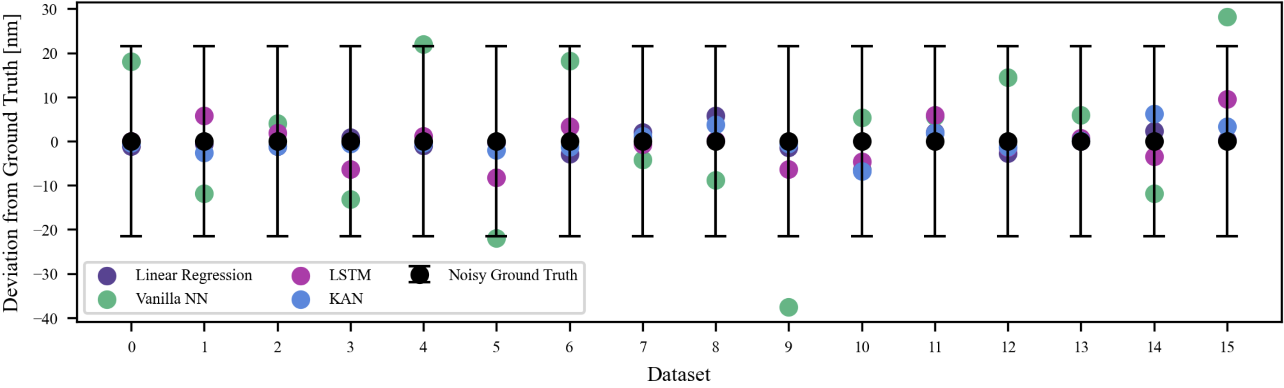
Evaluation: Creep
Endposition + encoder noise characteristic

Slide 16
Outlook
Create an inverse model to compensate the effects
Extend model to predict voltage for goal position
Integrate models into the controller of the manipulators

